Slide 1
Cloud Advocate Exam Q&A

Slide 2
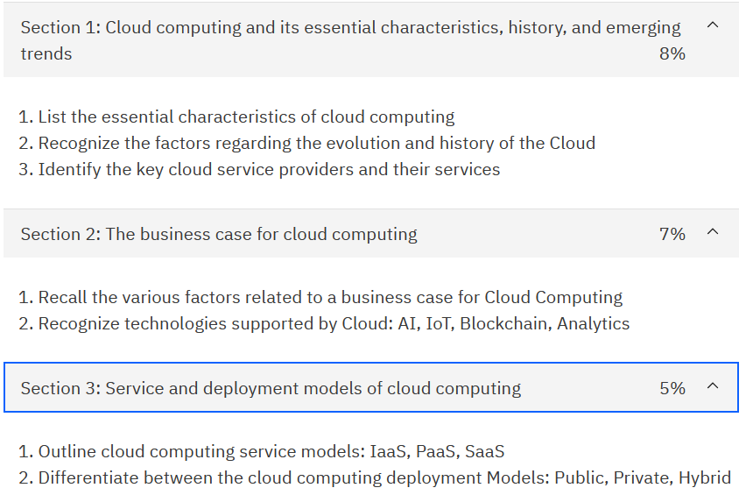
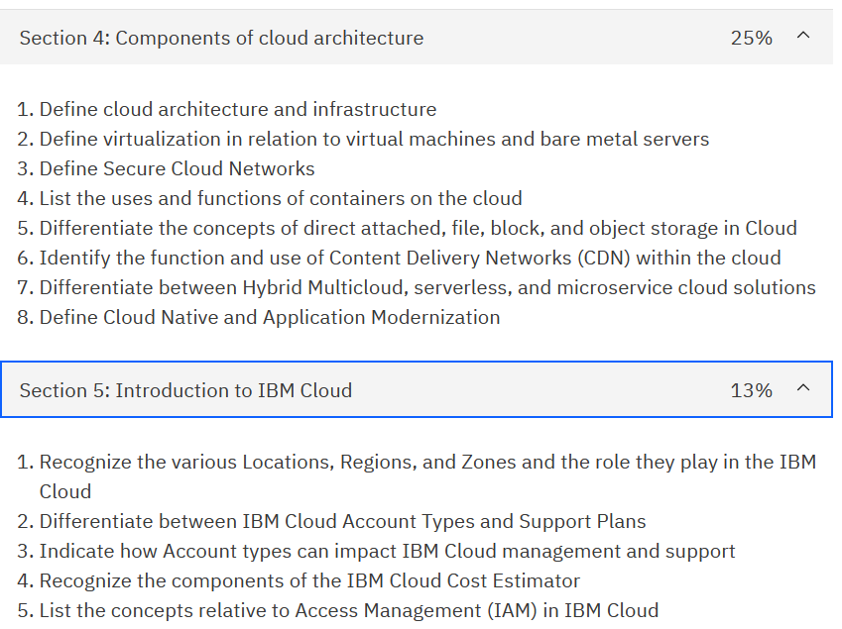
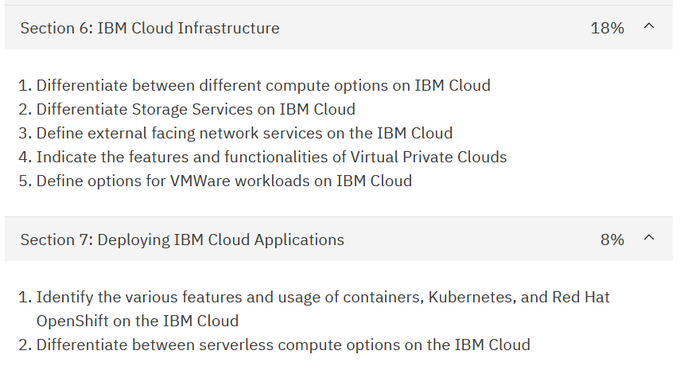

Slide 3
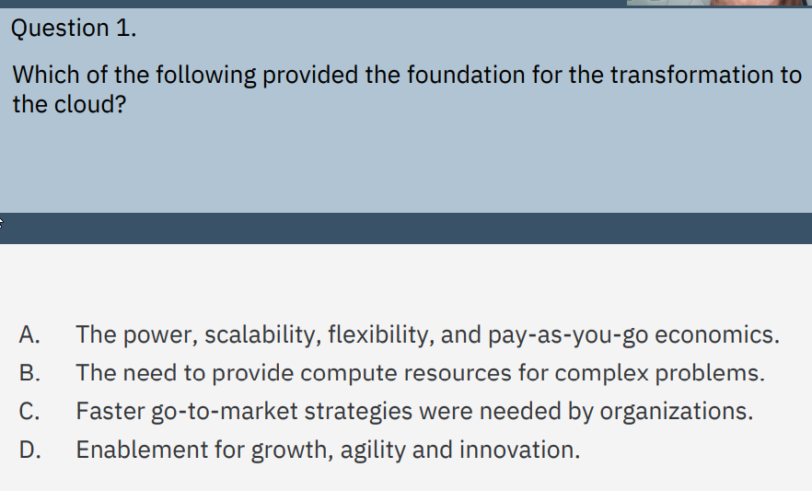
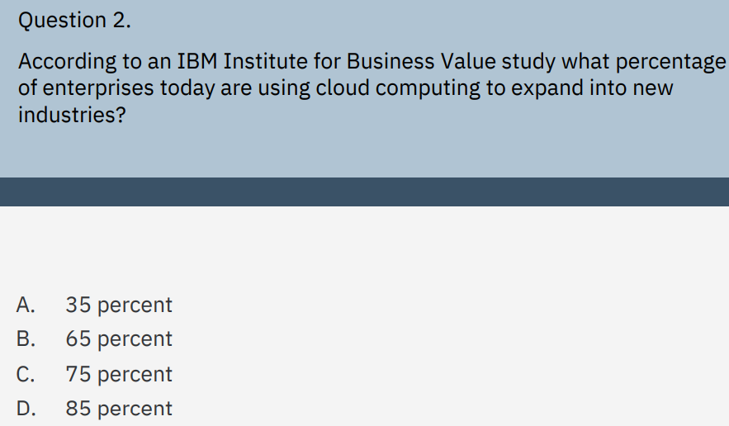
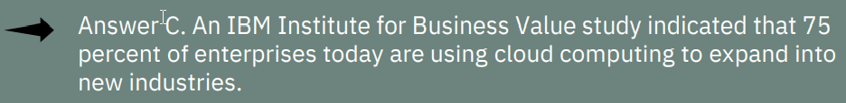
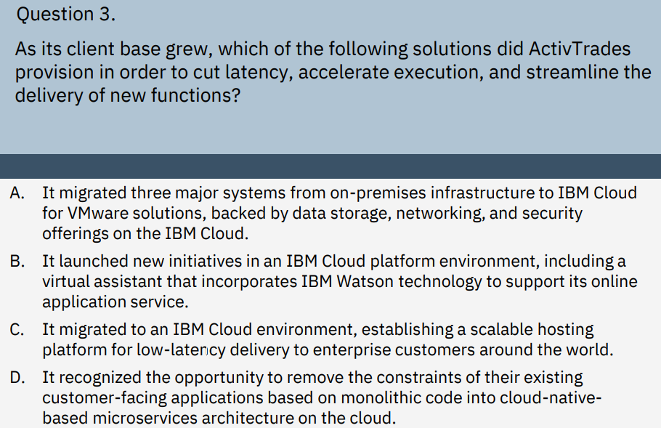
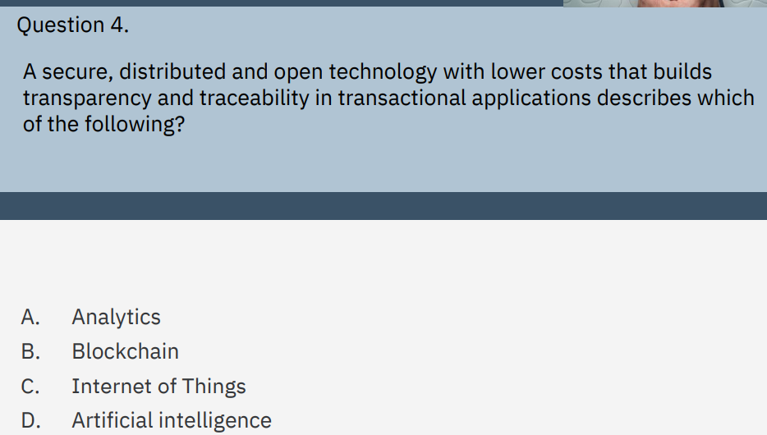
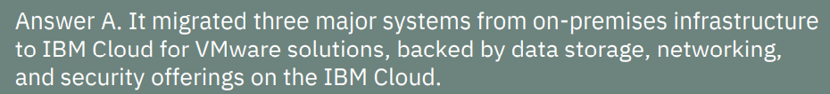
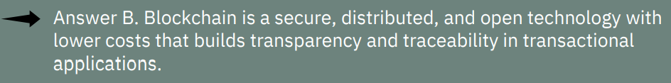

Slide 4
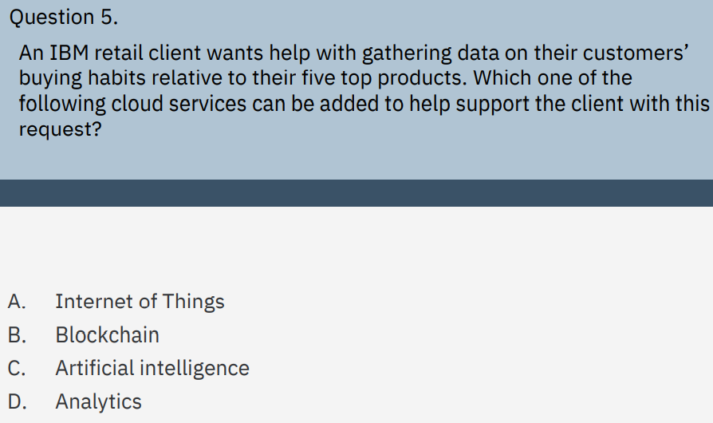
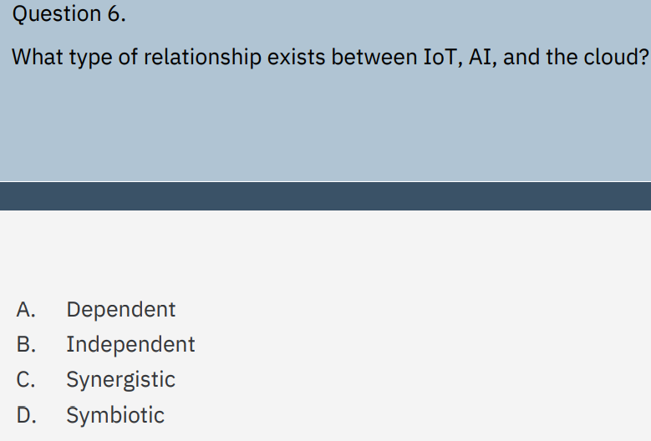
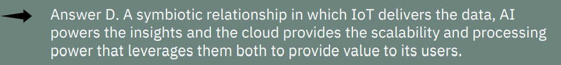
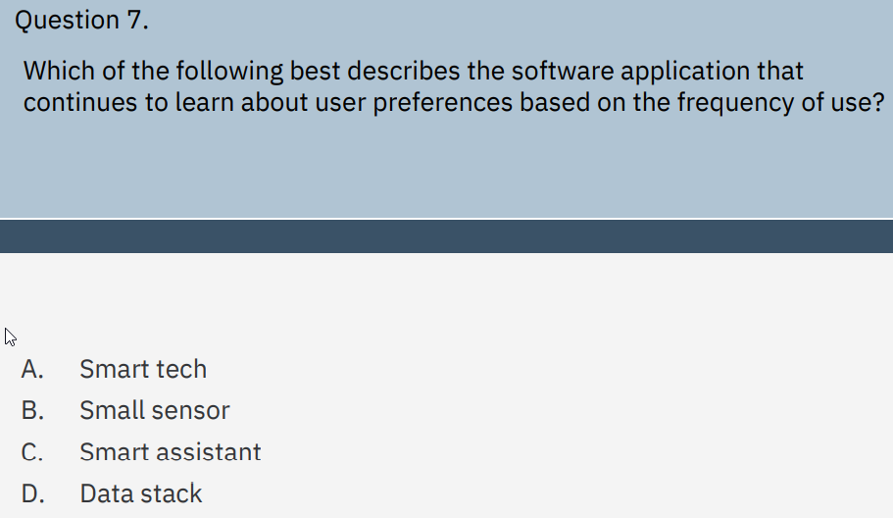
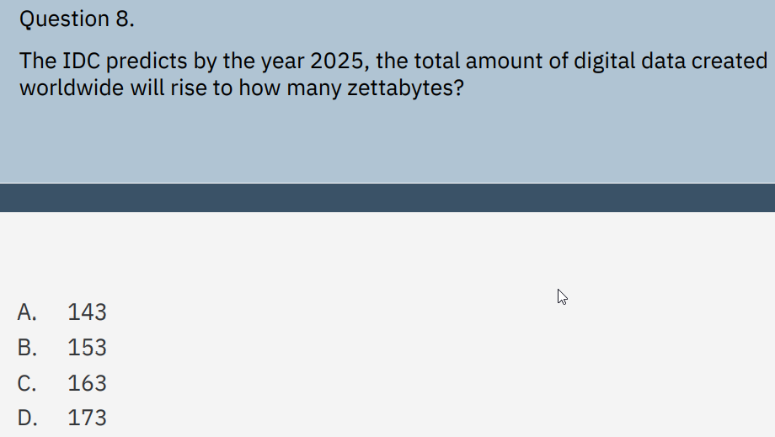
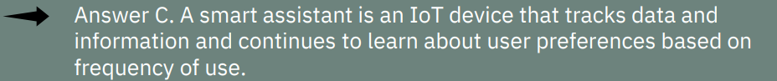

Slide 5
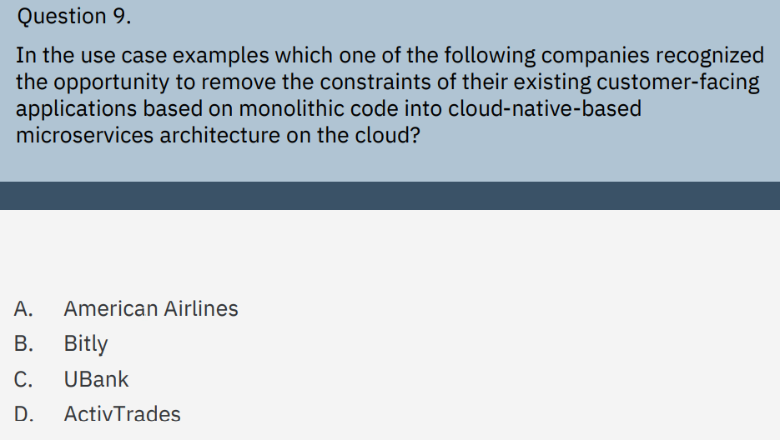
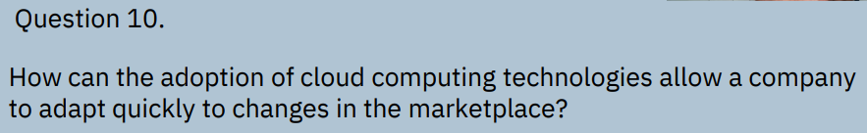
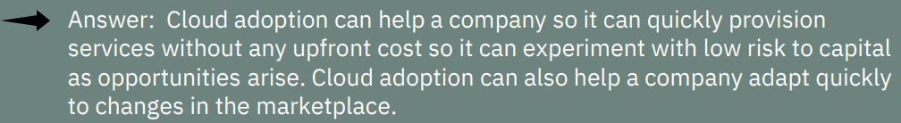
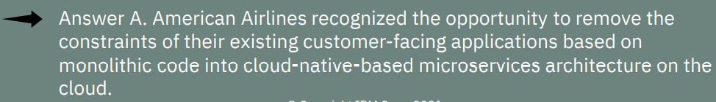

Slide 6
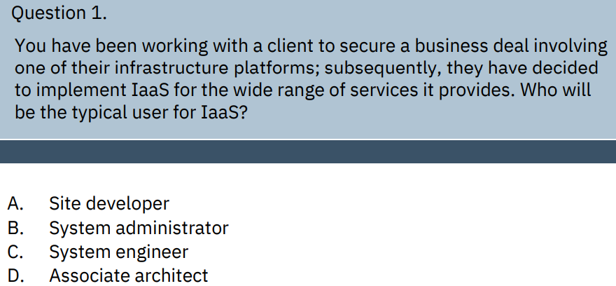
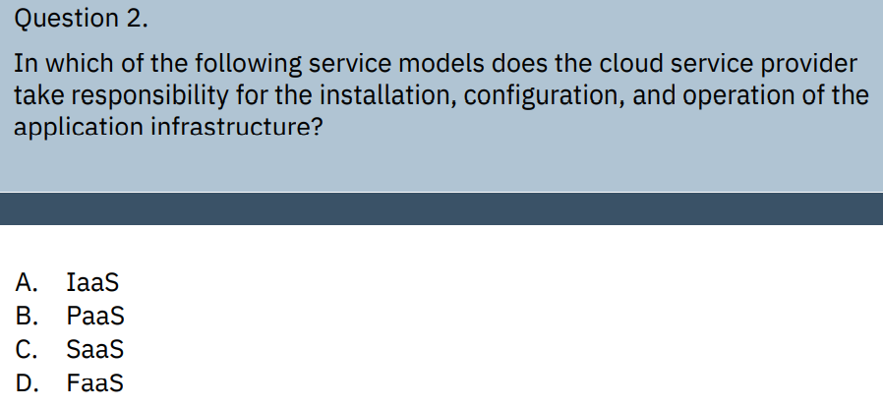
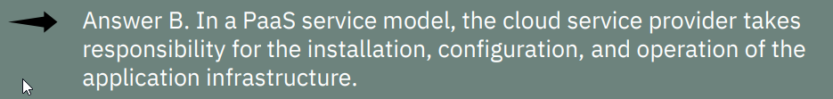
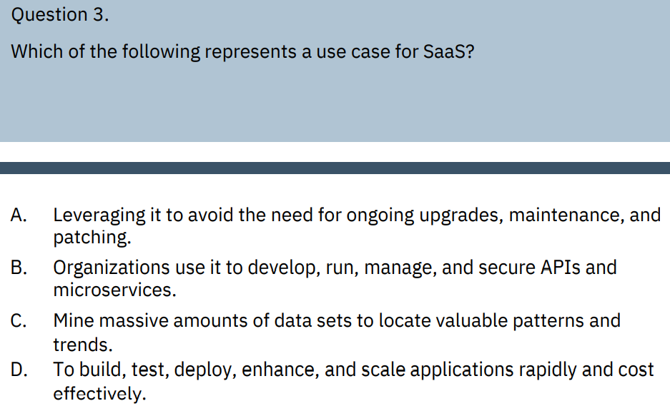
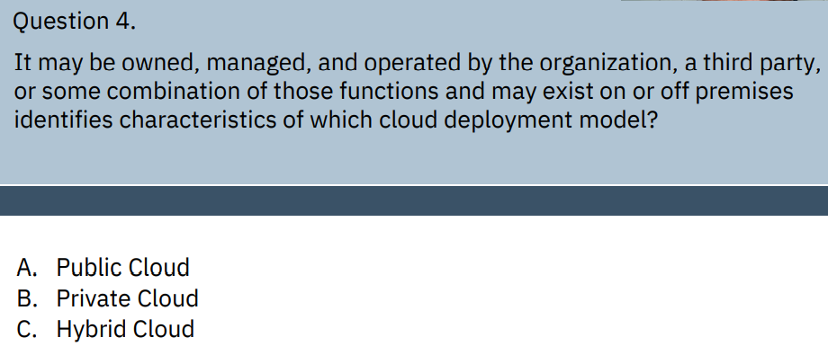
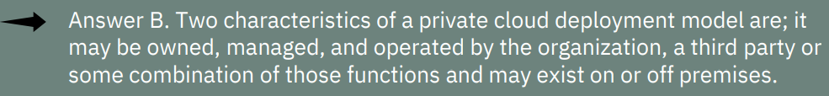
Module 3
**
Seems like
hybrid

Slide 7
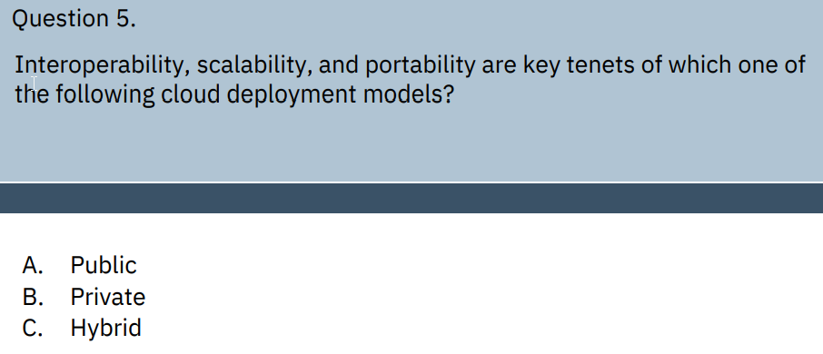
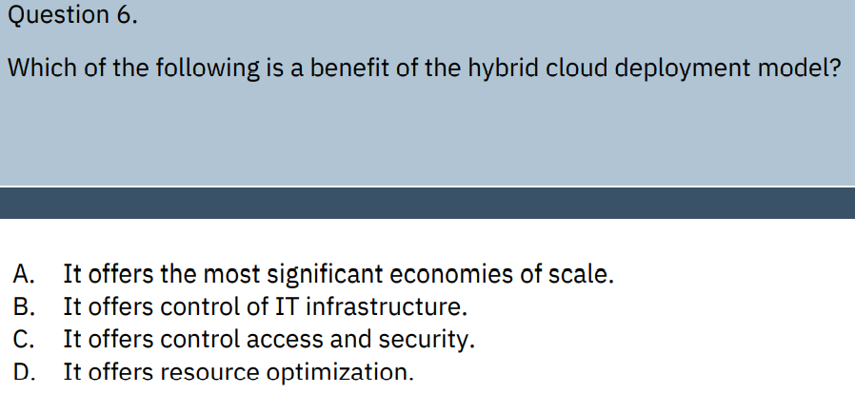
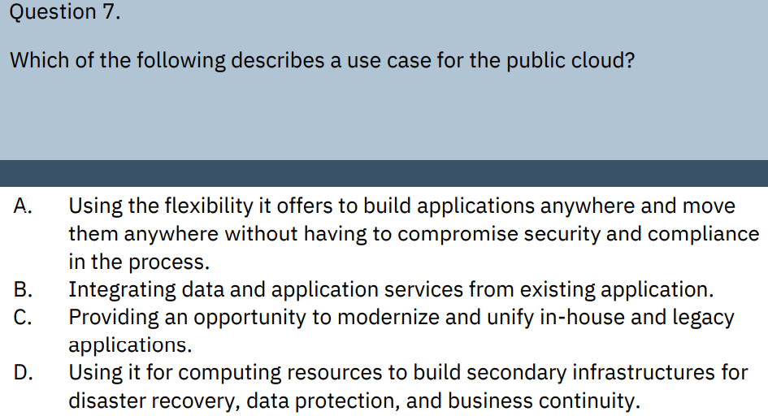
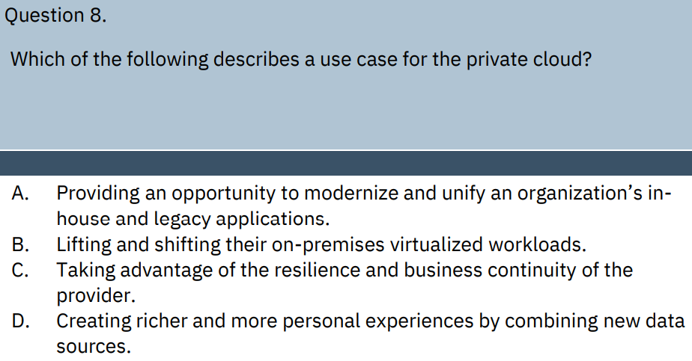
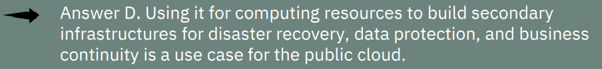
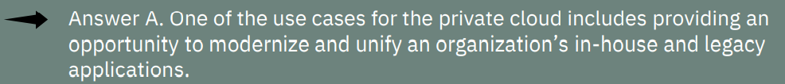
****HYBRID***
***Hybrid***
***Private***

Slide 8
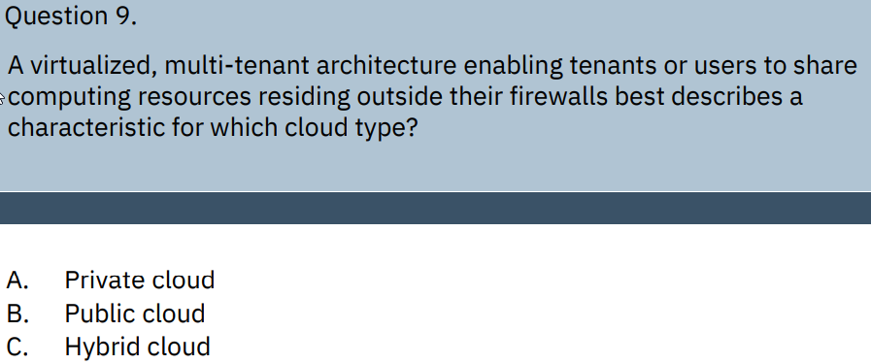
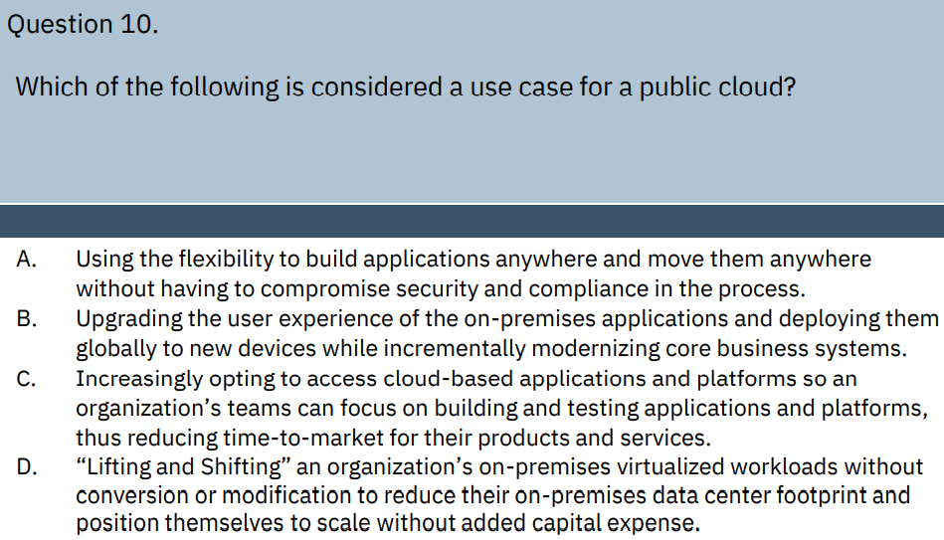
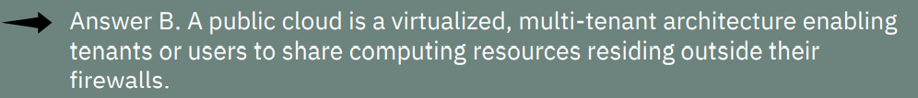
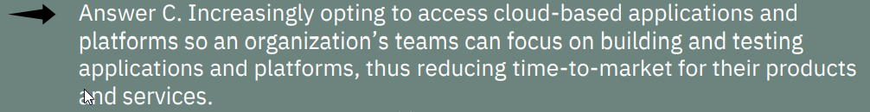
**Public Cloud**

Slide 9
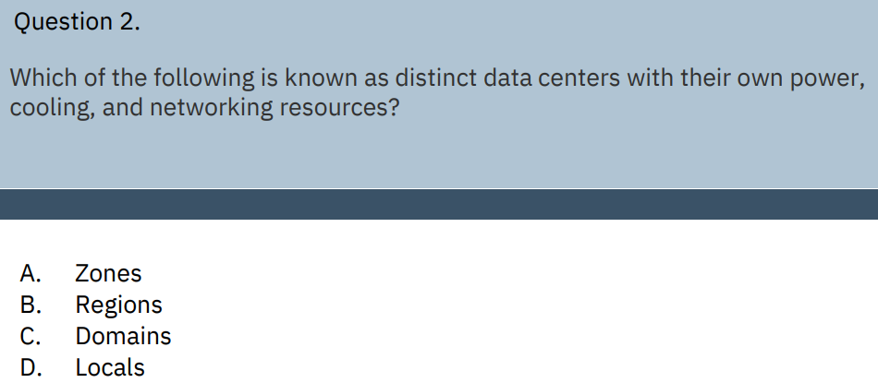
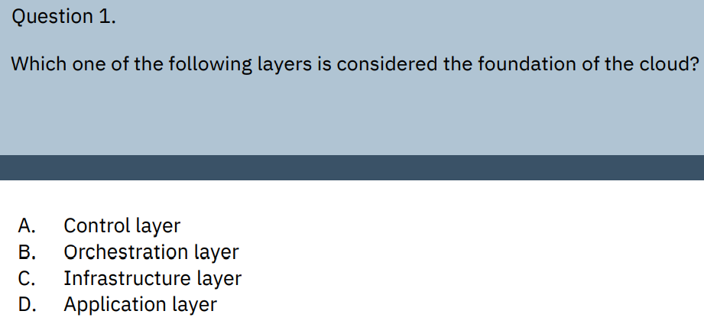
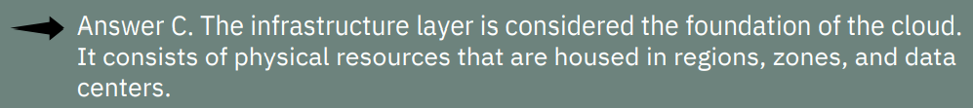
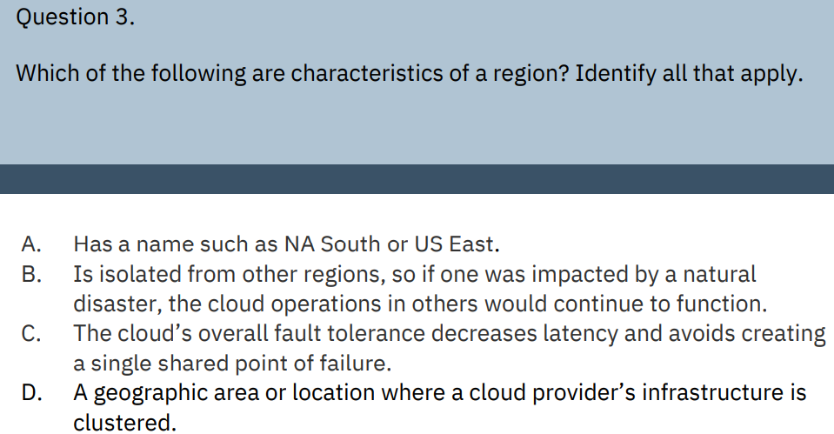
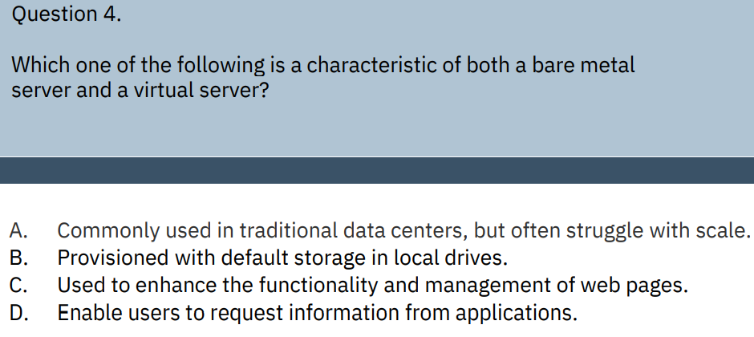
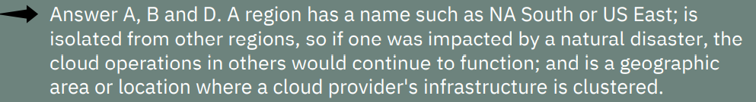
Section 4
***Zones***

Slide 10
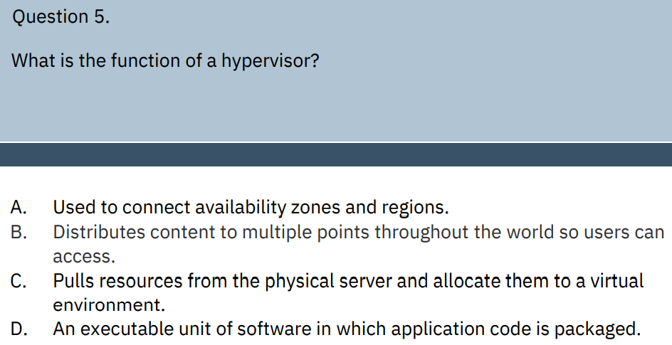
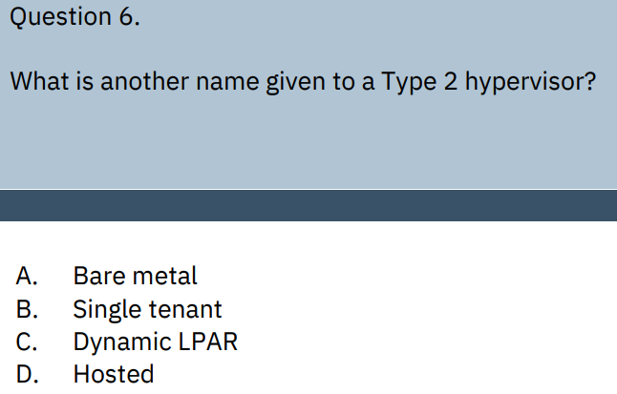

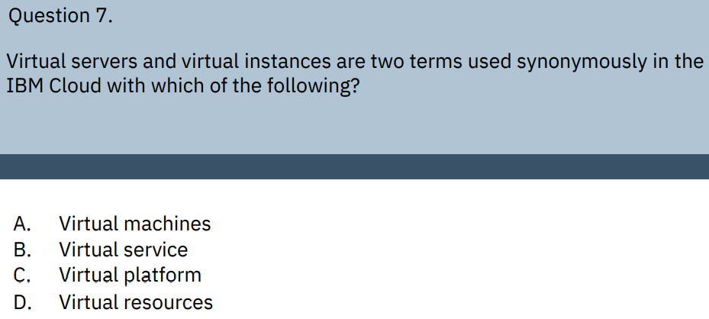
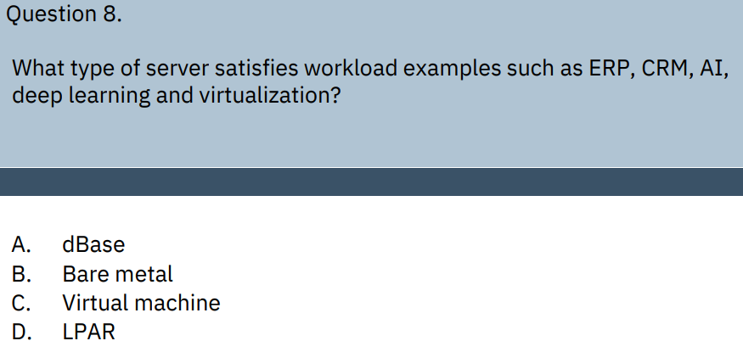

Slide 11
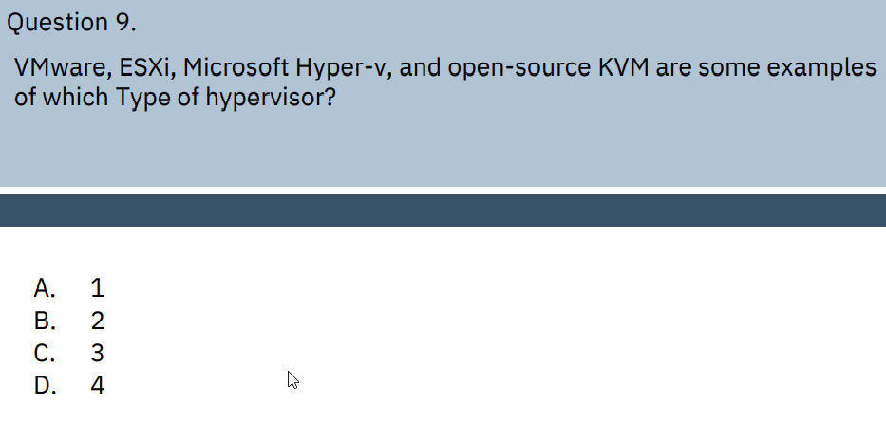
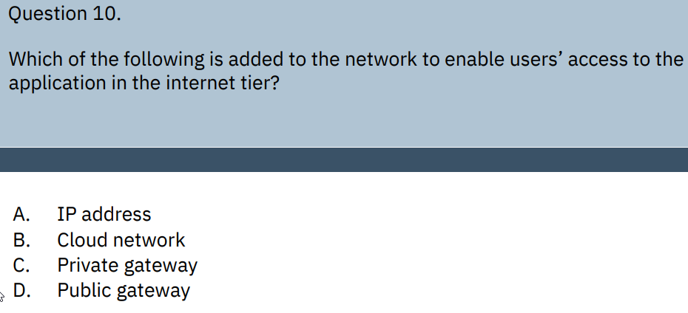
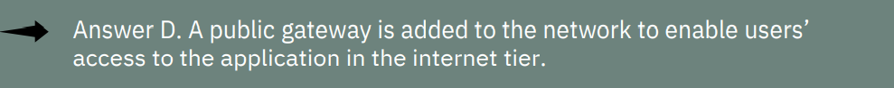
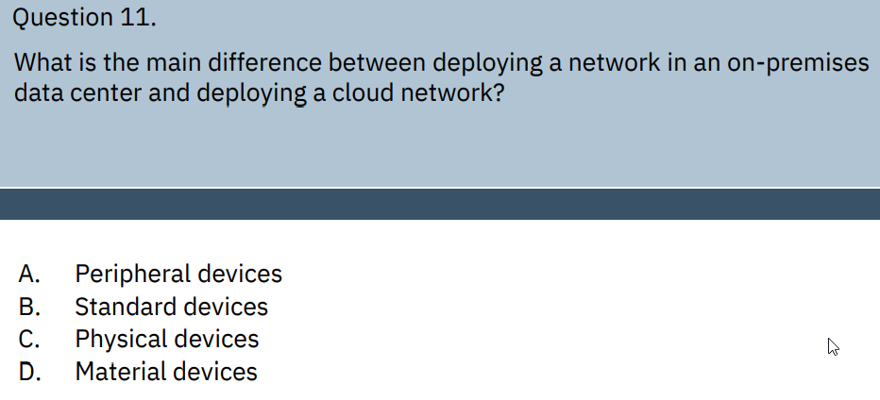



*****Type 1 is ESX, HyperV : Type 2 Parallels /VitualBox

Slide 12




Section 5
**Direct attached is slow for shared storage**
**Block Storage highly resilient
And used with Encryption**

Slide 13




**Direct attached,
OS only last as long as compute
Resource attached**

Slide 14


Slide 15
Section 6
Question 1. | Which of the following describes the type of cloud that leverages the best of the cloud models and services across different providers and where applications and workloads work seamlessly - across multiple different cloud types?
 | A. Private cloud
 | B. Hybrid cloud
 | C. Public cloud
 | D. Hybrid multicloud
Answer D. A hybrid multicloud describes the type of cloud that leverages the best of the cloud models and services across different providers where applications and workloads work seamlessly
across multiple different cloud types.
**Best of Cloud Models – ie Hybrid
Multiple providers – Multi cloud
Ans. Hybrid Multicloud**
Question 2. | Which of the following is described as an approach in which a single application is composed of many loosely coupled and independently deployable smaller components or services?
 | A. Application modernization
 | B. Hybrid multicloud
 | C. Microservices architecture
 | D. Virtualization
Answer C. Microservices architecture is an approach in which a single application is composed of many loosely coupled and independently deployable smaller components or services.
Question 3. | What are three key features of microservices?
Answers: Key features of microservices include:
 | Code can be updated more easily.
 | Teams can use different stacks and different programming languages for different components.
 | Components can be scaled independently of one another, reducing the waste and cost. List your answers in the space provided below.
Code updated easily
Can use diff stacks/lang
Scales independent of other

Slide 16
Question 4. | IBM Cloud Functions is a Function-as-a-Service (FaaS) programming platform used for developing lightweight code that scalably executes on demand. What open source serverless platform is it based on?
Answer D. IBM Cloud Functions is based on the Apache OpenWhisk open-source serverless platform.
IBM OpenWhist
AWS – Lamba
Azure – Functions/Logic apps
Question 5. | Which of the following best describes serverless computing?
 | A. Serverless computing means there are no physical servers utilized.
 | B. Serverless computing is a cloud computing execution model that provisions computing resources on demand and offloads all responsibility for common infrastructure management tasks to a cloud provider.
 | C. Serverless is an approach to computing that offloads responsibility for common infrastructure management tasks such as scaling, scheduling, patching, and provisioning to a company’s IT team.
 | D. Serverless computing is a model where the existence of servers becomes abstracted and without function.
Answer B. Serverless computing is a cloud computing execution model that provisions computing resources on demand and offloads all responsibility for common infrastructure management tasks.
Question 6. | A cloud-native application consists of _____________ working together as a whole to comprise an application, yet each can be independently scaled and iterated through automation and orchestration processes.
 | A. Microservices
 | B. Developers
 | C. Providers
 | D. Services
Answer A. A cloud-native application consists of microservices working together as a whole to comprise an application, yet each can be independently scaled and iterated through automation and orchestration processes.

Slide 17
Question 7. | Which of the following best describes a single-tiered software application in which the user interface and data access code are combined into a single program from a single platform? | Which of the following best describes a single-tiered software application in which the user interface and data access code are combined into a single program from a single platform?
 | A. Microservice | A. Microservice
 | B. Container | B. Container
 | C. Monolithic | C. Monolithic
 | D. Program | D. Program
Answer C. A monolithic application describes a single-tiered software application in which the user interface and data access code are combined into a single program from a single platform
Question 8. | Which of the following is considered a collaborative approach where business owners and the development, operations, and quality assurance teams collaborate to continuously deliver software.
 | A. Collaboration
 | B. DevOps
 | C. Modernization
 | D. Teamwork
Answer B. DevOps is considered a collaborative approach where business owners and the development, operations, and quality assurance teams collaborate to continuously deliver software.
Question 9. | Which of the following terms is often described as updating or improving legacy applications, their architecture, and the methods for developing them by using new technologies and modern methods for implementing them?
 | A. Application modernization
 | B. Microservices architecture
 | C. Software-as-a-Service
 | D. Application infrastructure
Answer A. Application modernization is often described as updating or improving legacy applications, their architecture, and the methods for developing them by using new technologies and modern methods for implementing them.

Slide 18
Question 10. | Which of the following include the common goals of application modernization? Select all that apply
 | A. Microservices architecture
 | B. DevOps
 | C. Cloud migration
 | D. Portability
Answers A, B, and C. Microservices architecture, DevOps, and Cloud migration are three common goals of application modernization
**Portability is not common goal of App Modernization***

Slide 19




Slide 20








Which compute option on IBM Cloud offers access to Z technology without requiring the purchase of Z hardware or requiring Z technology specific skills?
Resource Groups are used __________________.
 | To provide access to multiple resources at once | To provide access to multiple resources at once
 | Resource Groups are used to provide access to multiple resources at once. | Resource Groups are used to provide access to multiple resources at once.
Hyper Protect Service

Slide 21






Slide 22






Module 3 Deploying Applications
OKD not an acronym

Slide 23






Module 4 Services on IBM Cloud

Slide 24

Service Models:
IaaS, PaaS, SaaS
B
B
D

Slide 25

12 question
Certainly can reduce dev time*
Not always
Not always
Unknown
SaaS for Disaster Recovery – maybe for single machine
Yes,
No SaaS not sure
No
NO
NO
NO YES
4. A
5. B
6. D

Slide 26

YES
NO
NO
YES
NO
This is just Hybrid
*Best of Cloud Models (Multicloud) and many service providers
They really like this definition
This is just a Cloud Native architecture
SaaS or Paas
7. C
8. C
9. B

Slide 27

BEST
Didn’t know, this is best answer
A is the best answer
10. C
11. D
12. A

Slide 28


Introduction to Cloud | Free Courses in Data Science, AI, Cloud Computing, Containers, Kubernetes, Blockchain and more. (cognitiveclass.ai)
IBM Cloud Essentials V3 | Free Courses in Data Science, AI, Cloud Computing, Containers, Kubernetes, Blockchain and more. (cognitiveclass.ai)

Slide 29

Center for Cloud Training - IBM Training

Slide 30







Module 1
IBM Cloud Advocate Flash Card Study Preparation

Slide 31
Module 2
A secure, distributed, and open technology with lower costs that builds transparency and traceability in transactional applications describes what?
Blockchain
Blockchain is a secure, distributed, and open technology with lower costs that builds transparency and traceability in transactional applications.
What provided the foundation for the transformation to the cloud?
The power, scalability, flexibility, and pay-as-you-go economics.
The power, scalability, flexibility, and pay-as-you-go economics provided the foundation for the transformation to the cloud.
What describes a software application that continues to learn about user preferences based on the frequency of use?
Smart assistant
A Smart assistant is an IoT device that tracks data and information and continues to learn about user preferences based on frequency of use.
How can the adoption of cloud computing technologies allow a company to adapt quickly to changes in the marketplace?
A secure, distributed, and open technology with lower costs that builds transparency and traceability in transactional applications describes what?
Blockchain
Blockchain is a secure, distributed, and open technology with lower costs that builds transparency and traceability in transactional applications.
An IBM retail client wants help with gathering data on their customers’ buying habits relative to their five top products. Which cloud service can be added to help support the client with this request?
Analytics
Analytic technologies on the cloud can be leveraged to help the client track trends and analyze the data.
Cloud adoption can help a company adapt quickly to changes in the marketplace.
Cloud adoption can also help a company quickly provision services without any upfront cost so a business can experiment with low risk to capital as opportunities arise.
According to the International Data Corporation (IDC) by the year 2025, the total amount of digital data created worldwide will rise to how many zettabytes?
163
The IDC predicts by 2025, the total amount of digital data created worldwide will rise to 163 zettabytes.
As its client base grew, what solution did ActivTrades provision in order to cut latency, accelerate execution, and streamline the delivery of new functions?
It migrated three major systems from on-premises infrastructure to IBM Cloud for VMware solutions, backed by data storage, networking, and security offerings on the IBM Cloud.
Which company recognized the opportunity to remove the constraints of their existing customer-facing applications based on monolithic code into cloud-native based microservices architecture on the cloud?
American Airlines
American Airlines recognized the opportunity to remove the constraints of their existing customer-facing applications based on monolithic code into cloud-native based microservices architecture on the cloud.
A secure, distributed, and open technology with lower costs that builds transparency and traceability in transactional applications describes what?
Blockchain
Blockchain is a secure, distributed, and open technology with lower costs that builds transparency and traceability in transactional applications.
What type of relationship exists between IoT, AI, and the cloud?
Symbiotic
A symbiotic relationship in which IoT delivers the data, AI powers the insights, and the cloud provides the scalability and processing power that leverages them both to provide value to its users

Slide 32
Module 3 Cloud Computing Service and Deployment Models

Slide 33
Question Set 2 IBM Cloud Advocate

Slide 34



Module 1 - Graded Quiz

Slide 35



Module 2 - Introduction and Learning Objectives

Slide 36



Module 3 - Graded Quiz

Slide 37



Module 4 - Graded Quiz

Slide 38



Module 5 - Graded Quiz

Slide 39



Module 6 - Graded Quiz

Slide 40


Reading: Module 7 Summary

Slide 41





Slide 42





Slide 43





Slide 44





Slide 45



Slide 46
Module 1 Overview of Cloud Computing
What separates virtual machines logically, assigning each its own slice of underlying computing power, memory and storage, thus preventing the virtual machines from interfering with each other?
Hypervisor
A hypervisor separates virtual machines logically, assigning each its own slice of underlying computing power, memory and storage, thus preventing the virtual machines from interfering with each other.
What is another term used for the utility billing method?
Pay-as-you-go
Pay-as-you-go is another term used for the utility billing method.
Infrastructure as a Service (IaaS), Platform as a Service (PaaS) and Software as a Service (SaaS) are generally known as what?
Service models
IaaS, PaaS and SaaS are generally known as the service models.
Which type of computing environment connects an organization’s on-premises private cloud and a third-party public cloud into a single flexible infrastructure for running applications and workloads?
Hybrid
A hybrid cloud is a computing environment that connects an organization’s on-premises private cloud and third-party public cloud into a single flexible infrastructure for running applications and workloads.

Slide 47
Access to infrastructure and physical computing resources such as servers, networking, storage, and data center space best describes what?
Infrastructure as a Service (IaaS)
Infrastructure as a Service (IaaS) is described as access to infrastructure and physical computing resources such as servers, networking, storage, and data centers.
Which cloud service provider specializes in Software-as-a-Service (SaaS) focused on customer relationship management?
Salesforce
Salesforce is the cloud service provider that specializes in Software-as-a Service (SaaS) focused on customer relationship management.
What is considered a perceived risk of cloud computing?
Data security
Data security is considered a perceived risk of cloud computing.
How does the National Institute of Standards and Technology (NIST) define cloud computing?
A model for enabling convenient, on-demand network access to a shared pool of compute resources.
NIST defines cloud computing as a model for enabling convenient, on-demand network access to a shared pool of compute resources.

Slide 48
In which decade did the practice of time sharing or resource pooling evolve to make more efficient use of computing power via the mainframe?
1950s
During the 1950s the practice of time sharing or resource pooling evolved to make more efficient use of computing power via the mainframe.

Slide 49
Module 2 Cloud Adoption and Emerging Technologies
How can the adoption of cloud computing technologies allow a company to adapt quickly to changes in the marketplace?
Cloud adoption can help a company adapt quickly to changes in the marketplace.
Cloud adoption can also help a company quickly provision services without any upfront cost so a business can experiment with low risk to capital as opportunities arise.
What provided the foundation for the transformation to the cloud?
The power, scalability, flexibility, and pay-as-you-go economics.
The power, scalability, flexibility, and pay-as-you-go economics provided the foundation for the transformation to the cloud.
As its client base grew, what solution did ActivTrades provision in order to cut latency, accelerate execution, and streamline the delivery of new functions?
It migrated three major systems from on-premises infrastructure to IBM Cloud for VMware solutions, backed by data storage, networking, and security offerings on the IBM Cloud.
What type of relationship exists between IoT, AI, and the cloud?
Symbiotic
A symbiotic relationship in which IoT delivers the data, AI powers the insights, and the cloud provides the scalability and processing power that leverages them both to provide value to its users.

Slide 50
A secure, distributed, and open technology with lower costs that builds transparency and traceability in transactional applications describes what?
Blockchain
Blockchain is a secure, distributed, and open technology with lower costs that builds transparency and traceability in transactional applications.
What describes a software application that continues to learn about user preferences based on the frequency of use?
Smart assistant
A Smart assistant is an IoT device that tracks data and information and continues to learn about user preferences based on frequency of use.
According to an IBM Institute for Business Value study what percentage of enterprises today are using cloud computing to expand into new industries?
75 percent
An IBM Institute for Business Value study indicated that 75 percent of enterprises today are using cloud computing to expand into new industries.
An IBM retail client wants help with gathering data on their customers’ buying habits relative to their five top products. Which cloud service can be added to help support the client with this request?
Analytics
Analytic technologies on the cloud can be leveraged to help the client track trends and analyze the data.

Slide 51
Which company recognized the opportunity to remove the constraints of their existing customer-facing applications based on monolithic code into cloud-native based microservices architecture on the cloud?
American Airlines
American Airlines recognized the opportunity to remove the constraints of their existing customer-facing applications based on monolithic code into cloud-native based microservices architecture on the cloud.
According to the International Data Corporation (IDC) by the year 2025, the total amount of digital data created worldwide will rise to how many zettabytes?
163
The IDC predicts by 2025, the total amount of digital data created worldwide will rise to 163 zettabytes.

Slide 52
What is the maximum storage volume supported for block or file storage on IBM Cloud virtual and bare metal servers?
Up to 12 TB
The maximum storage volume for block or file storage is 12 TB.
Which compute option on IBM Cloud offers access to Z technology without requiring the purchase of Z hardware or requiring Z technology specific skills?
Hyper Protect Service
Hyper Protect Service offers access to Z technology without requiring the purchase of Z hardware or having Z-specific skills
Which network infrastructure service is used to distribute a workload between multiple servers?
Load Balancer
The Load Balancer is used to distribute a workload between multiple services.
Which virtual server instance is billed hourly and monthly?
Public virtual server
Public virtual server instances are billed hourly and monthly.
What enables communication to the internet for all virtual server instances on the attached subnet?
Public Gateway
A public gateway enables communication to the internet for all virtual server instances on the attached subnet.
Which service in the IBM Cloud platform is used to backup and replicate virtual machines on VMware?
Veeam
Veeam is used to back up and replicate virtual machines on VMware.

Slide 53
Which service can assist a client in connecting an application in IBM Cloud with their private network?
VPN
A VPN service can assist a client in connecting an application on IBM Cloud with the client’s private network.
Which compute option on IBM Cloud are the Citrix, VMware, and Cloud Linux images associated with?
Bare Metal Service
Bare Metal Service provides images for Citrix, VMware, IBM Cloud Linux, among others.
What are private subnets and encrypted communication channels used for?
Achieve isolation between workloads on VPCs on IBM Cloud
Private subnets and encrypted communication channels are used to achieve isolation between workloads on VPCs on IBM Cloud.
Which IBM Cloud service provides virtual servers and bare metal servers with SAN-like iSCSI storage?
IBM Block Storage
IBM Block Storage provides SAN-like iSCSI storage to both virtual and bare metal servers.

Slide 54
If an organization has a VMware shared environment, who is responsible for the management and operation of that environment?
IBM
In a VMware shared environment, IBM is responsible for the management and operation of the environment.
What service is NOT provided by IBM Cloud Internet Services?
Auditing
Auditing is not provided by IBM Cloud Internet Services.
Module 3 Cloud Computing Service and Deployment Models
What would be a use case for the public cloud?
Using it for computing resources to build secondary infrastructures for disaster recovery, data protection, and business continuity

Slide 55
Module 3 Cloud Computing Service and Deployment Models
You have been working with a client to secure a business deal involving one of their infrastructure platforms; subsequently, they have decided to implement IaaS for the wide range of services it provides.
Who will be the typical user for IaaS?
System administrator
The user/persona for IaaS is the system administrator.
It may be owned, managed, and operated by the organization, a third party or some combination of those functions and may exist on or off premises identifies characteristics of which cloud deployment model?
Private cloud
Two characteristics of a private cloud deployment model are it may be owned, managed, and operated by the organization, a third party or some combination of those functions and it may exist on or off premises.
What represents a use case for SaaS?
Leveraging it to avoid the need for ongoing upgrades, maintenance, and patching.
Leveraging SaaS to avoid the need for ongoing software upgrades, maintenance, and patching is considered a use case for SaaS.
Interoperability, scalability, and portability are key tenets of which cloud deployment model?
Hybrid
The key tenets of a hybrid cloud are interoperability, scalability, and portability.

Slide 56
In which service model does the cloud service provider take responsibility for the installation, configuration, and operation of the application infrastructure?
PaaS
In a PaaS service model, the cloud service provider takes responsibility for the installation, configuration, and operation of the application infrastructure.
What would be another use case for a public cloud?
Increasingly opting to access cloud-based applications and platforms so an organization’s teams can focus on building and testing applications and platforms, thus reducing time-to-market for their products and services.
What would be a use case for the private cloud?
Providing an opportunity to modernize and unify an organization’s in-house and legacy applications
A virtualized, multi-tenant architecture enabling tenants or users to share computing resources residing outside their firewalls best describes a characteristic for which cloud type?
Public cloud
A public cloud is a virtualized, multi-tenant architecture enabling tenants or users to share computing resources residing outside their firewalls.
What is a benefit of the hybrid cloud deployment model?
It offers resource optimization
One of the benefits to the hybrid cloud is it offers resource optimization − not being locked in with a specific vendor.

Slide 57
Uses automated rollouts and rollbacks to deploy and manage containers, scales services up or down automatically based on utilization and monitors the health of services to prevent bad rollouts are characteristics of what type of system?
Kubernetes
Kubernetes characteristics include but are not limited to using automated automated rollouts and rollbacks to deploy and manage containers, scaling services up or down automatically based on utilization and monitoring the health of services to prevent bad rollouts.
What type of platform is the IBM Cloud Functions offering?
FaaS
IBM Cloud Functions is a Functions-as-a-Service (FaaS) programming platform.
What is a characteristic of a container?
A container is a package that contains application source code dependencies, like runtimes, binaries, libraries, and data.
What are the building blocks of serverless architecture?
Actions
Actions are the building blocks of serverless architecture.
Fill in the blank.
A ______ is configured to communicate with a specific Kubernetes cluster.
Container.
A container is configured to communicate with a specific Kubernetes cluster.
What is a feature of OpenShift?
OpenShift issues quarterly releases with the latest being 4.4 based on 1.17 is considered a feature of OpenShift.

Slide 58
Fill in the blank.
Kubernetes is an open source container orchestration project that simplifies everything associated with deploying and managing ______.
Containers
Kubernetes is an open source container orchestration project that simplifies everything associated with deploying and managing containers.
Refers to building and running applications that do not require server management, enables a simpler, more cost-effective way to build and operate cloud-native applications and describes a finer grade deployment model where applications are bundled as one or more functions are characteristics of what type of computing?
Serverless computing
Serverless computing characteristics include but are not limited to building and running applications that do not require server management, enabling a simpler, more cost-effective way to build and operate cloud-native applications and is a finer grade deployment model where applications are bundled as one or more functions.
Can run uniformly inconsistent across any platform or cloud, share the host OS kernel increasing speed and inefficiency and provides increased security and isolation are benefits of what cloud component?
Containers
Containers can run uniformly inconsistent across any platform or cloud, share the host OS kernel increasing speed and inefficiency and provides increased security and isolation.
OpenShift is based on which open source project?
OKD
OpenShift is based on the open source OKD Project.

Slide 59
What are known as distinct Data Centers with their own power, cooling, and networking resources?
Zones
Zones are typically known as distinct data centers with their own power, cooling, and network resources. Module 4 Components of Cloud Computing
VMware, ESXi, Microsoft Hyper-v and open-source KVM are some examples of which type of hypervisor?
Type 1
VMware, ESXi, Microsoft Hyper-v, and open-source KVM are examples of a type 1 hypervisor.
Which cloud layer would be considered the foundation of the cloud?
The Infrastructure layer
The infrastructure layer is considered the foundation of the cloud. It consists of physical resources that are housed in regions, zones and data centers.
What are the characteristics of a region?
A region has a name such as NA South or US East; is isolated from other regions, so if one was impacted by a natural disaster, the cloud operations in others would continue to function; and is a geographic area or location where a cloud provider's infrastructure is clustered.

Slide 60
What is the function of a hypervisor?
Pulls resources from the physical server and allocates them to a virtual environment
The function of a hypervisor is to pull resources from the physical server and allocate them to a virtual environment.
Virtual servers and virtual instances are two terms used synonymously in the IBM Cloud with which other term?
Virtual machines
Virtual machines is the term used synonymously with virtual servers and virtual instances in the IBM Cloud.
What type of server satisfies workload examples such as ERP, CRM, AI, deep learning and virtualization?
Bare metal
Bare metal servers satisfy workload examples such as ERP, CRM, AI, deep learning, and virtualization.
What is another name given to a Type 2 hypervisor?
Hosted
Type 2 hypervisors are also known as hosted.
What could be added to a network to enable users’ access to the application in the internet tier?
Public gateway
A public gateway is added to the network to enable users’ access to the application in the internet tier.
What would be a characteristic of both a bare metal server and a virtual server?
Provisioned with default storage in local drives
Both a bare metal and a virtual server are provisioned with default storage in local drives.

Slide 61
What is the main difference between deploying a network in an on-premises data center and deploying a cloud network?
Physical devices
The main difference is in the cloud, the logical instances of networking elements are used as opposed to the use of physical devices used in an on-premises facility.
Portability, scalability, streamlined development, and deployment of cloud-native applications and architectures are some of the advantages of which type of component?
Containers
The advantages of containers include portability, scalability, streamlined development, and deployment of cloud-native applications and architectures.

Slide 62
Module 4 Services on IBM Cloud
Which database is classified as a document-oriented database?
MongoDB
MongoDB is considered a document-oriented database.
Fill in the blank.
Hyperledger fabric is the framework for building ________ applications.
Blockchain
Hyperledger fabric is the framework for building blockchain applications.
What is the Internet of Things (IoT)?
The Internet of Things (IoT) is best described as a system of interrelated computing devices that transfer data over a network without requiring human interaction.
Which IBM Cloud service is used to run and deploy machine learning models anywhere across any cloud?
Watson Machine Learning
Watson Machine Learning is used to run and deploy machine learning models anywhere across any cloud.
What is an Event Stream?
Event Stream integrates with Watson Internet of Things (IoT) and IBM Cloud functions to leverage event streams.

Slide 63
Fill in the blank.
IBM Cloud Paks can run on any platform because they are installed on top of ____________.
OpenShift
Provisioning OpenShift and installing an IBM Cloud Pak on top of OpenShift allows IBM Cloud Paks to run anywhere.
Fill in the blank.
Tekton pipelines are specified in __________.
YAML
Tekton pipelines are specified in YAML.
What is Watson Assistant used for?
Watson Assistant is used to build conversational interfaces into any application device or channel.
Which practice includes frequently committing code to prevent significant drift, competing changes, and merge conflicts?
Continuous Integration
Continuous Integration includes frequently committing code to prevent significant drift, competing changes, and merge conflicts.
Which type of database would be appropriate for shopping cart data?
Key-Value databases
Key-Value databases are commonly used for leaderboards, caches, and shopping cart data.
What is the Analytics Engine service?
The Analytics Engine deploys and develops applications using Apache Spark and Apache Hadoop.

Slide 64
Which IBM Cloud Pak provides tools to automate the implementation of business policies?
IBM Cloud Pak for Business Automation
IBM Cloud Pak for Business Automation provides tools to automate the implementation of business policies.

Slide 65
Module 5 Cloud Computing Storage and Content Delivery Networks
Poor performance when data needs to be shared is considered a disadvantage of which type of storage?
Direct attached
Poor performance when data needs to be shared is considered a disadvantage of direct attached storage.
How does a Content Delivery Network reduce the distance between website visitors and the website server?
A Content Delivery Network stores content in geographically distributed locations (proxy servers and data centers) globally.
What is the purpose of a content delivery network (CDN)?
To make websites faster and more responsive
A content delivery network (CDN) makes websites faster and more responsive.
Highly available and resilient and will often include data encryption at rest and in transit are characteristics attached to what type of storage?
Block storage
Characteristics of block storage include, highly available, and resilient and will often include data encryption at rest and in transit.

Slide 66
Module 5 Cloud Computing Storage and Content Delivery Networks
Which type of storage is accessed via an application program interface (API), and is not attached to a compute node?
Object storage
Object storage is accessed via an application program interface (API), and it is not attached to a compute node.
Describe a characteristic of direct attached storage?
The operating system only last as long as the compute resource is attached to it
One of the characteristics of direct attached storage is that the operating system only lasts as long as the compute resource is attached to it. It is deleted after the virtual instance is terminated.
What is the definition of a Content Delivery Network?
A Content Delivery Network is a distributed server network that delivers temporarily stored, or cached, copies of website content to users based on the users’ geographical location.
Which type of storage is also referred to network attached storage, network file storage, or simply NFS?
File storage
File storage is also referred to network attached storage, network file storage, or simply NFS.

Slide 67
Direct-attached, file, block, and object are examples of what?
Types of cloud storage
Direct-attached, file, block, and object are considered types of cloud storage.
Describe a characteristic of object storage?
Great repository for all sorts of unstructured data types
A characteristic of object storage is that it is a great repository for all sorts of unstructured data types – videos, logs, backups, data from IoT, application binaries, and virtual machine images.

Slide 68
Module 6 Emergent Trends, Cloud Native, DevOps, and Application Modernization
Which type of cloud leverages the best of the cloud models and services across different providers, and where applications and workloads work seamlessly across multiple different cloud types?
Hybrid-Multicloud
A hybrid-multicloud describes the type of cloud that leverages the best of the cloud models and services across different providers, and where applications and workloads work seamlessly across multiple different cloud types.
What is a single-tiered software application in which the user interface and data access code are combined into a single program from a single platform?
Monolithic
A monolithic application describes a single-tiered software application in which the user interface and data access code are combined into a single program from a single platform.
What are three key features of microservices?
Key features of microservices include: code can be updated more easily. Teams can use different stacks and different programming languages for different components. Components can be scaled independently of one another, reducing the waste and cost.
Describe serverless computing?
Serverless computing is a cloud computing execution model that provisions computing resources on demand and offloads all responsibility for common infrastructure management tasks.

Slide 69
IBM Cloud Functions is a Function-as-a-Service (FaaS) programming platform used for developing lightweight code that scalable executes on demand. What open source serverless platform is it based on?
Apache OpenWhisk
IBM Cloud Functions is based on the Apache OpenWhisk open source serverless platform.
Describe an approach in which a single application is composed of many loosely coupled and independently deployable smaller components or services?
Microservices architecture
Microservices architecture is an approach in which a single application is composed of many loosely coupled and independently deployable smaller components or services.
Fill in the Blank.
A cloud native application consists of _____________ working together as a whole to comprise an application, yet each can be independently scaled and iterated through automation and orchestration processes.
microservices
A cloud native application consists of microservices working together as a whole to comprise an application, yet each can be independently scaled and iterated through automation and orchestration processes.
What is considered a collaborative approach where business owners and the development, operations, and quality assurance teams collaborate to continuously deliver software.
DevOps
DevOps is considered a collaborative approach where business owners and the development, operations, and quality assurance teams collaborate to continuously deliver software.

Slide 70
What are the common goals of Application Modernization?
Microservices architecture, DevOps and cloud migration are three common goals of application modernization.
What term is often described as updating or improving legacy applications, their architecture, and the methods for developing them by using new technologies and modern methods for implementing them?
Application modernization
Application modernization is often described as updating or improving legacy applications, their architecture, and the methods for developing them by using new technologies and modern methods for implementing them.

